Slide 1

Presentation Materials Created by Mimetics Inc.
Free use by anyone for non-commercial purposes
Copyrights, Trademarks and other Registered Marks the Property of their Owners

Slide 2

Grade 6 - Class 4
Introduction to Scratch
Notes:
We want to introduce the Jade Robot and it’s Tools in more detail along with our action plans for it.
It’s interesting, but it’s easy to criticize something when it’s done (especially when you have experience) – a *LOT* more difficult getting it right from the start. Also, preparing this presentation was a great way to review and think about what we should be doing.

Slide 3
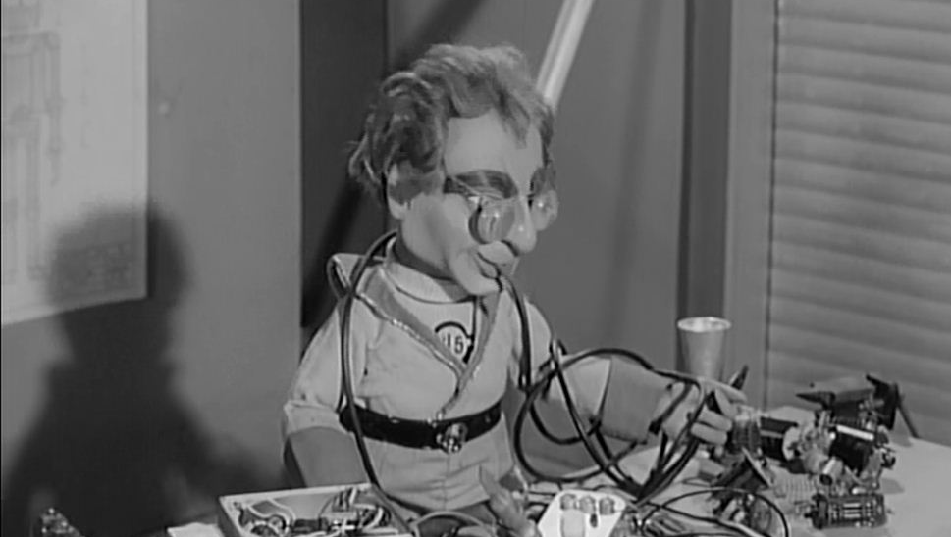
Rule One
Robots Run on the Floor
Notes:
Can Demo Jade Scratch if people are interested. In doing this product I’ve had a few interesting discoveries – one was going with a simpler programming language actually has a *LOT* of value for an expert like myself.

Slide 4

Rule Two
We ALL Stay Together
Notes:
Can Demo Jade Scratch if people are interested. In doing this product I’ve had a few interesting discoveries – one was going with a simpler programming language actually has a *LOT* of value for an expert like myself.

Slide 5
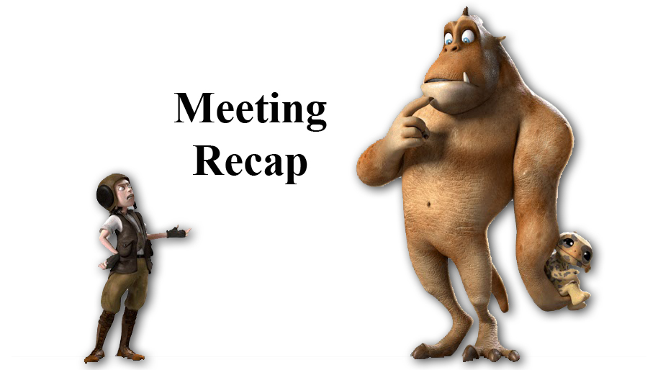
Recap
What is Programming?
How do the Jade Robot’s Tracks Move the Robot?
Notes:
Can Demo Jade Scratch if people are interested. In doing this product I’ve had a few interesting discoveries – one was going with a simpler programming language actually has a *LOT* of value for an expert like myself.

Slide 6
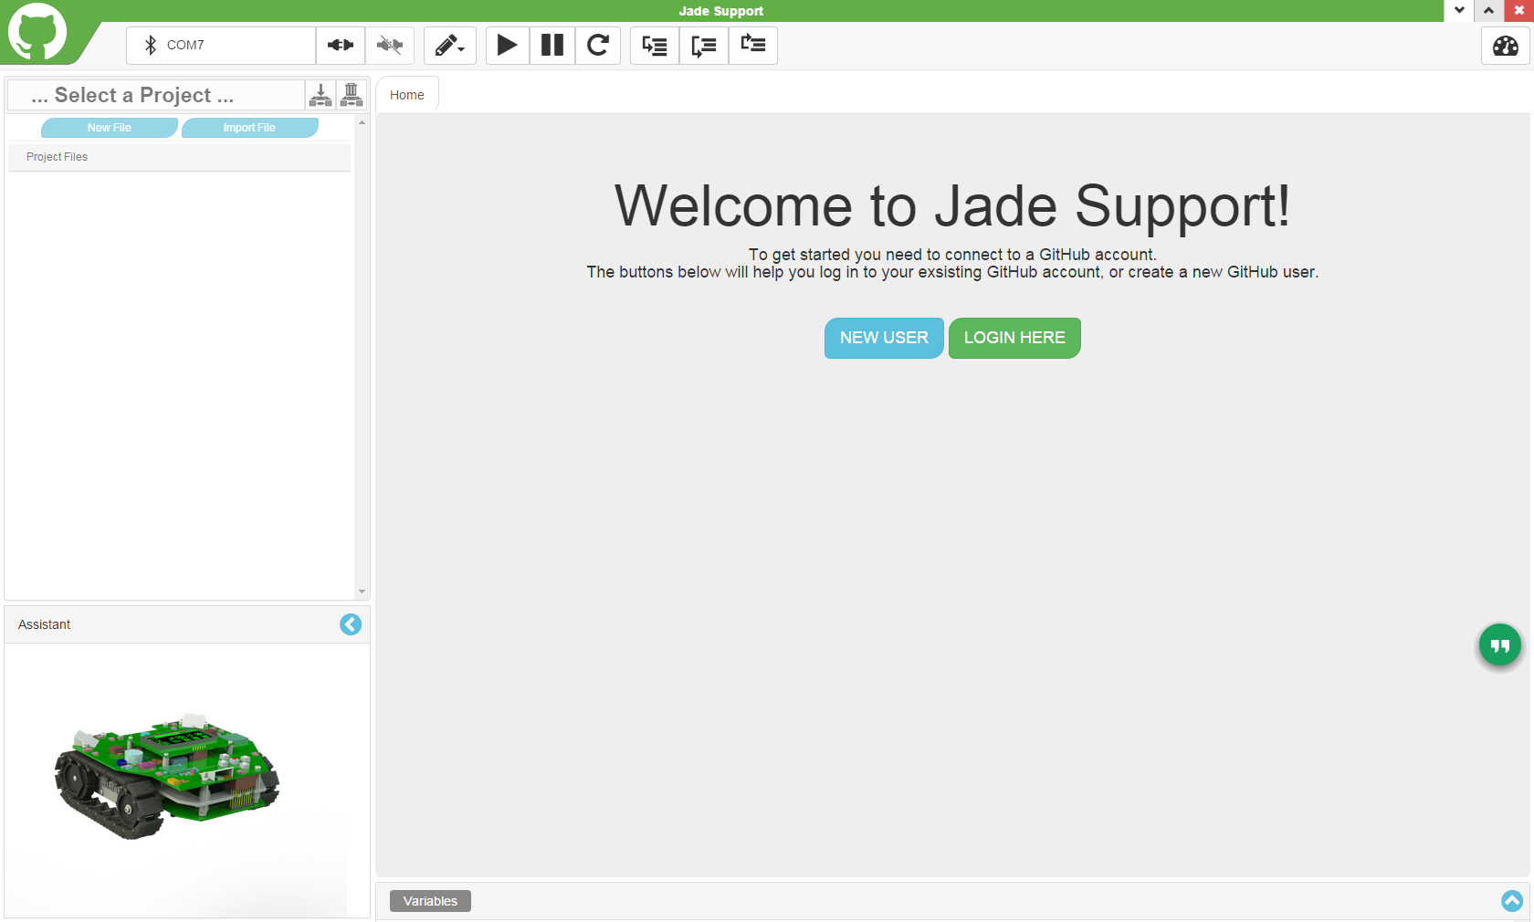
Click “Login Here” next Time
Click “New User” for First Time
Notes:
Can Demo Jade Scratch if people are interested. In doing this product I’ve had a few interesting discoveries – one was going with a simpler programming language actually has a *LOT* of value for an expert like myself.

Slide 7
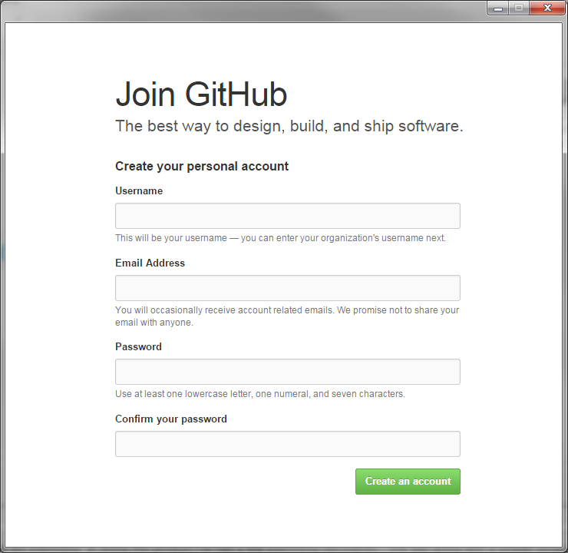
Choose a Username
Put in TDSB Email
Use “Password1”
Notes:
Can Demo Jade Scratch if people are interested. In doing this product I’ve had a few interesting discoveries – one was going with a simpler programming language actually has a *LOT* of value for an expert like myself.

Slide 8
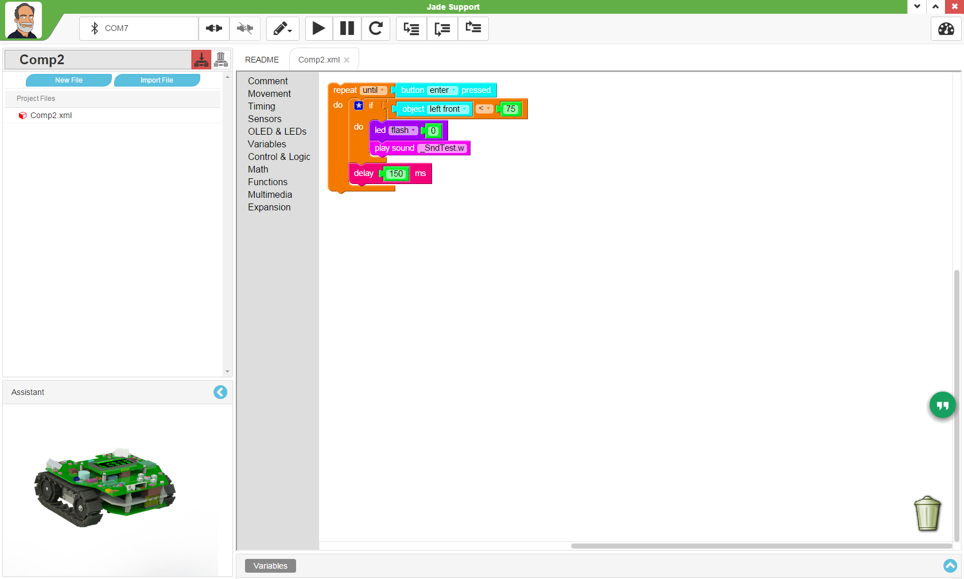
Execution Controls
Connection Controls
Project
Selection
Toolboxes
Scratch Workbench
Notes:
Can Demo Jade Scratch if people are interested. In doing this product I’ve had a few interesting discoveries – one was going with a simpler programming language actually has a *LOT* of value for an expert like myself.

Slide 9
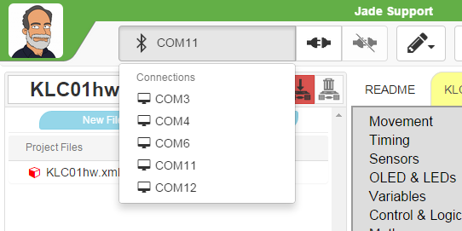
Selected Com Port
Connect Icon
Disconnect
Jade Com Ports
(Windows Only)
Notes:
Can Demo Jade Scratch if people are interested. In doing this product I’ve had a few interesting discoveries – one was going with a simpler programming language actually has a *LOT* of value for an expert like myself.

Slide 10
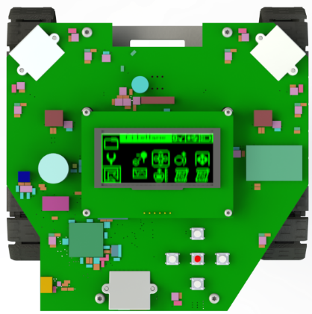
Robot Motion
Tracks Moving in
Same Direction &
Same Speed
Tracks Moving in
Different Direction
Or Different Speed
Notes:
Can Demo Jade Scratch if people are interested. In doing this product I’ve had a few interesting discoveries – one was going with a simpler programming language actually has a *LOT* of value for an expert like myself.

Slide 11
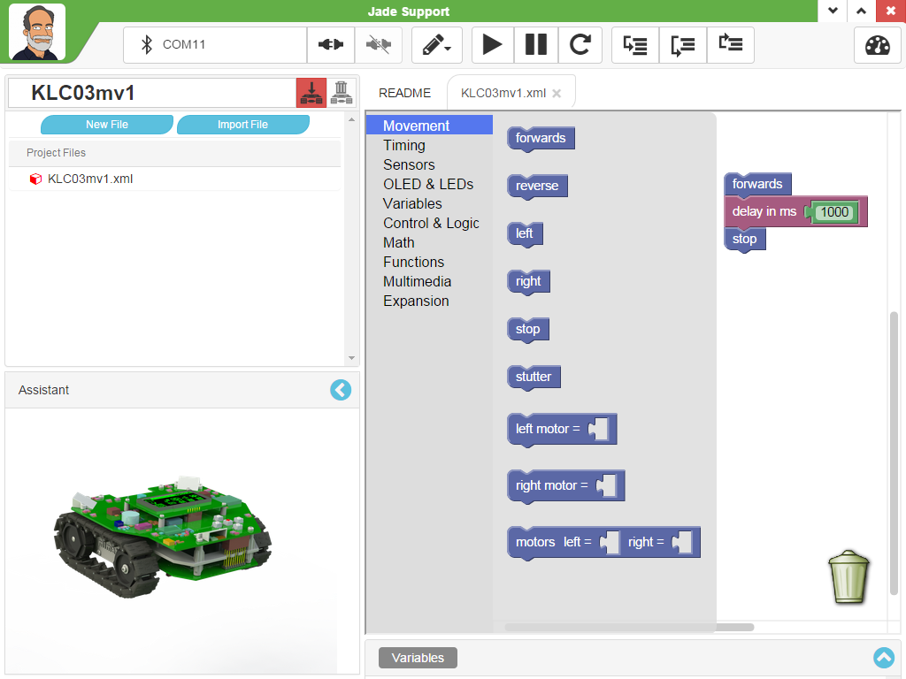
Movement Continues Until Changed
Set Individual Motor Values
-100 – Full Reverse
0 - Stop
100 – Full Forwards
Notes:
Can Demo Jade Scratch if people are interested. In doing this product I’ve had a few interesting discoveries – one was going with a simpler programming language actually has a *LOT* of value for an expert like myself.

Slide 12
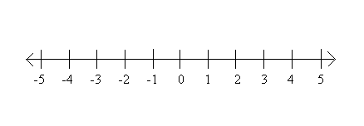
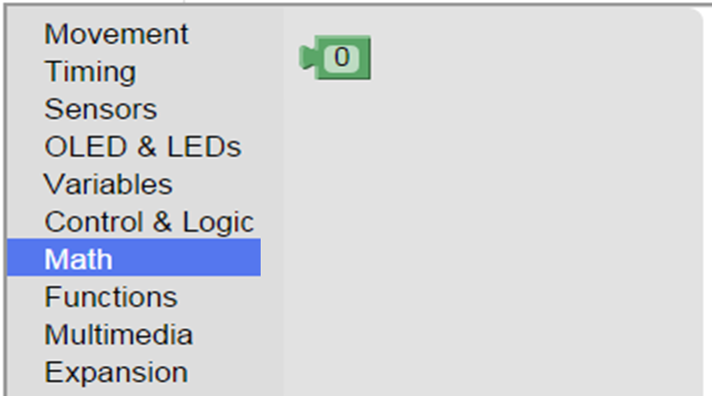
To +2.1Billion
To -2.1Billion
Constant Integer Value
Notes:
Can Demo Jade Scratch if people are interested. In doing this product I’ve had a few interesting discoveries – one was going with a simpler programming language actually has a *LOT* of value for an expert like myself.

Slide 13
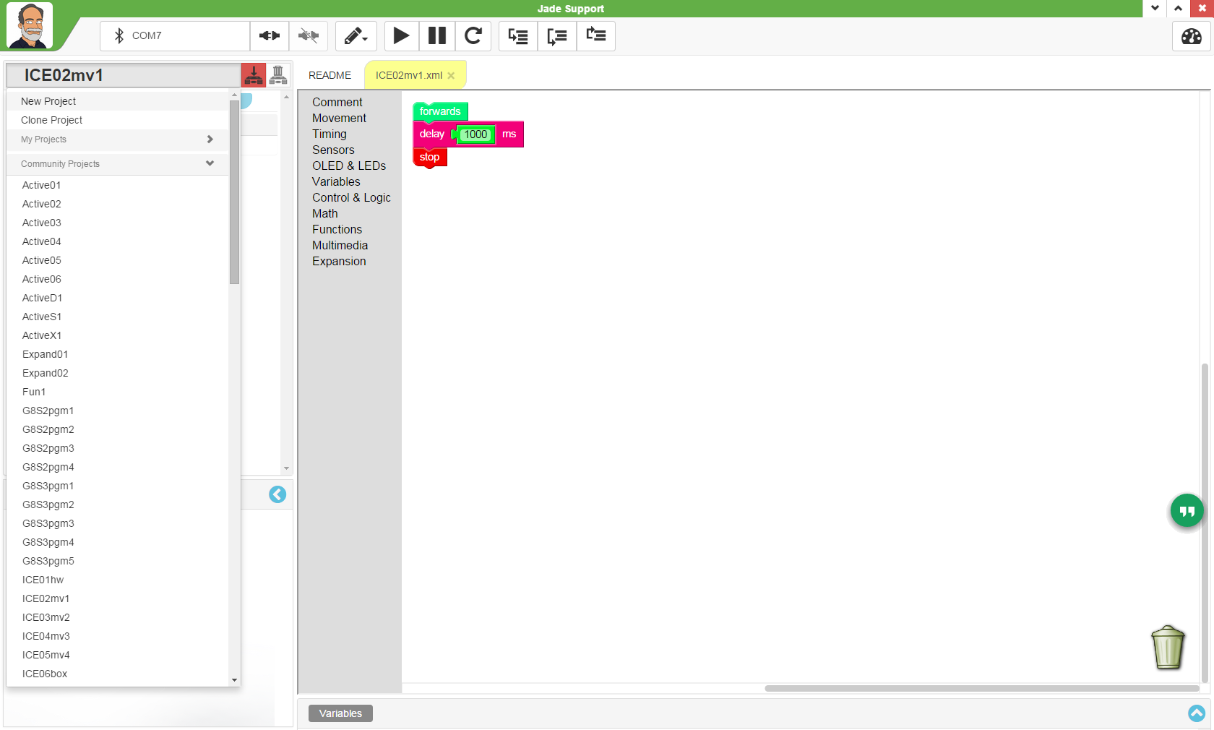
Movement Continues Until Changed
Click
Project
Bar
Set Individual Motor Values
-100 – Full Reverse
0 - Stop
100 – Full Forwards
Click
“New Project”
Notes:
Can Demo Jade Scratch if people are interested. In doing this product I’ve had a few interesting discoveries – one was going with a simpler programming language actually has a *LOT* of value for an expert like myself.

Slide 14
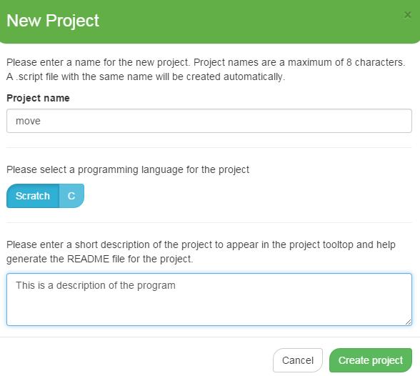
Movement Continues Until Changed
Enter
“move”
as Name
Put in
Description
Click
Project
Bar
Notes:
Can Demo Jade Scratch if people are interested. In doing this product I’ve had a few interesting discoveries – one was going with a simpler programming language actually has a *LOT* of value for an expert like myself.

Slide 15
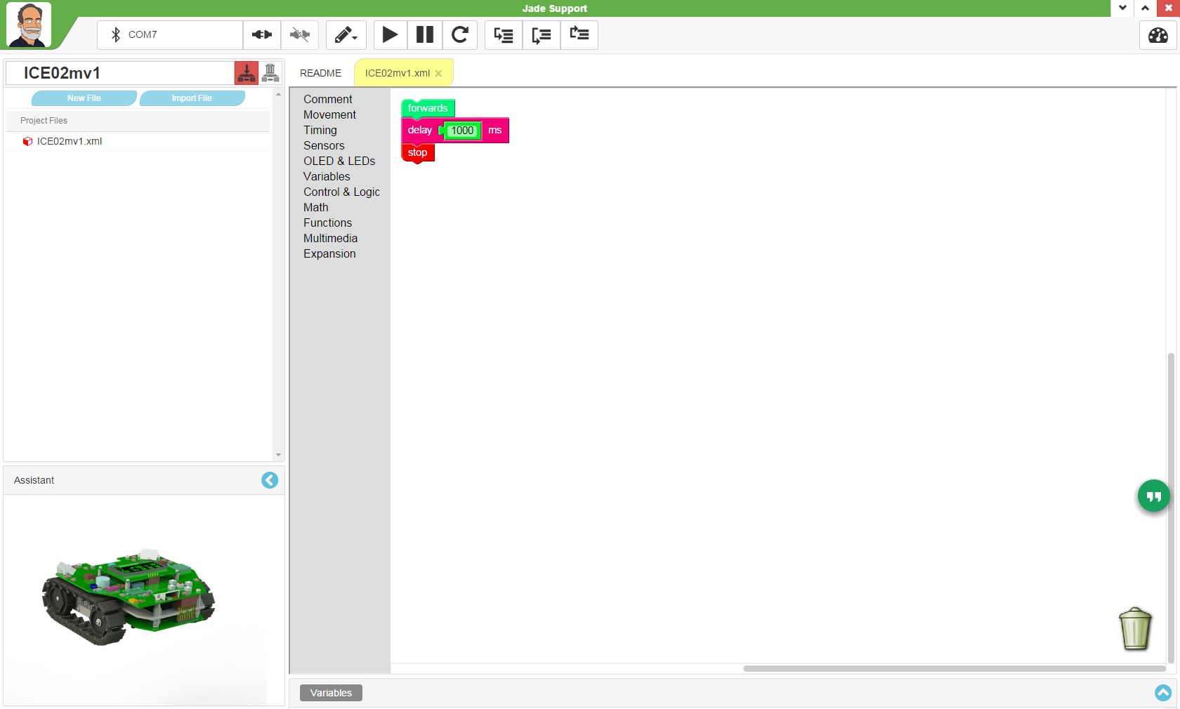
Start Robot Moving
Forwards
(Movement Toolbox)
Move for 1s
(Timing Toolbox)
Stop Robot Movement
(Movement Toolbox)
“move”
Notes:
Can Demo Jade Scratch if people are interested. In doing this product I’ve had a few interesting discoveries – one was going with a simpler programming language actually has a *LOT* of value for an expert like myself.

Slide 16
Single Step
Pause Program
Run Program
Reset Program
Transfer Program
To Robot
Notes:
Can Demo Jade Scratch if people are interested. In doing this product I’ve had a few interesting discoveries – one was going with a simpler programming language actually has a *LOT* of value for an expert like myself.

Slide 17

Experiment
Add Additional Movements
Change “delay” Times
Notes:
Can Demo Jade Scratch if people are interested. In doing this product I’ve had a few interesting discoveries – one was going with a simpler programming language actually has a *LOT* of value for an expert like myself.

Slide 18
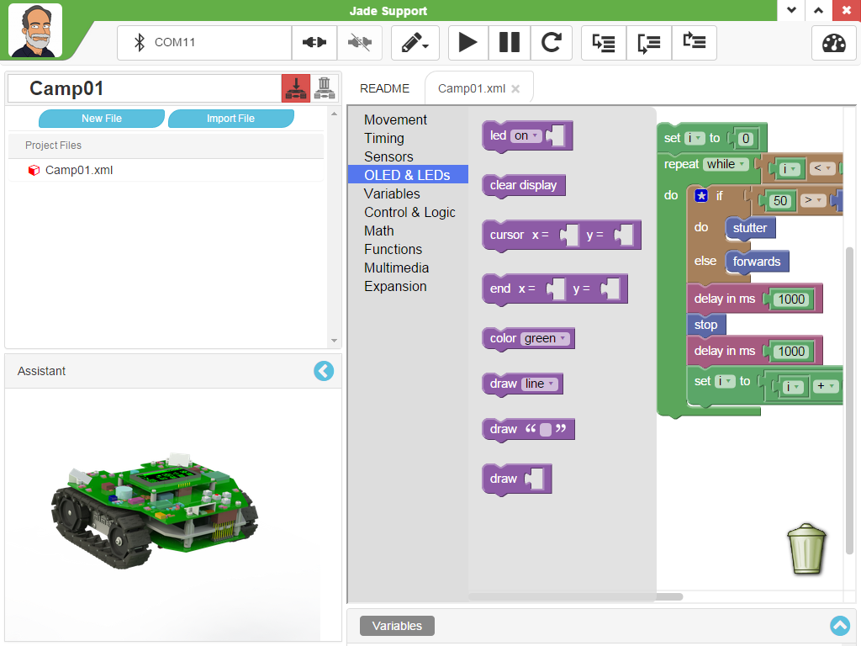
LED & OLED Status Updates Blocks
LED On/Off/Flash – LEDs 0 - 5
Clear OLED Display
Set Position of Next “draw”
“draw” Text String, Cursor Updated
“draw” Integer, Cursor Updated
Notes:
Can Demo Jade Scratch if people are interested. In doing this product I’ve had a few interesting discoveries – one was going with a simpler programming language actually has a *LOT* of value for an expert like myself.

Slide 19
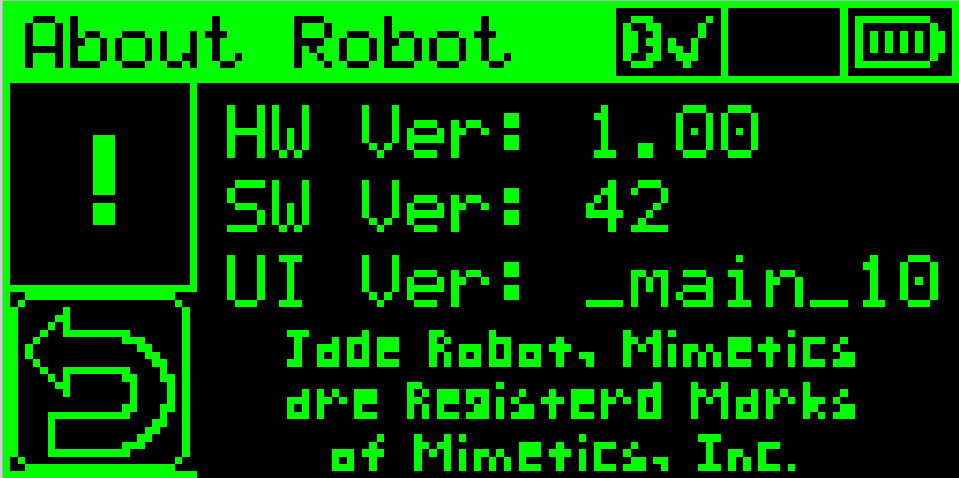
OLED Display
Origin (0,0)
End (127, 63)
Notes:
Can Demo Jade Scratch if people are interested. In doing this product I’ve had a few interesting discoveries – one was going with a simpler programming language actually has a *LOT* of value for an expert like myself.

Slide 20
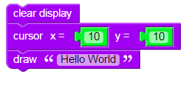
“DrawOut”
Notes:
Can Demo Jade Scratch if people are interested. In doing this product I’ve had a few interesting discoveries – one was going with a simpler programming language actually has a *LOT* of value for an expert like myself.

Slide 21

Experiments
Change Message
Move Message
Add More Messages
Notes:
Can Demo Jade Scratch if people are interested. In doing this product I’ve had a few interesting discoveries – one was going with a simpler programming language actually has a *LOT* of value for an expert like myself.

Slide 22
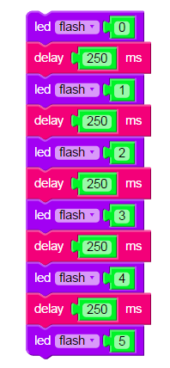
“LEDOut”
Notes:
Can Demo Jade Scratch if people are interested. In doing this product I’ve had a few interesting discoveries – one was going with a simpler programming language actually has a *LOT* of value for an expert like myself.

Slide 23
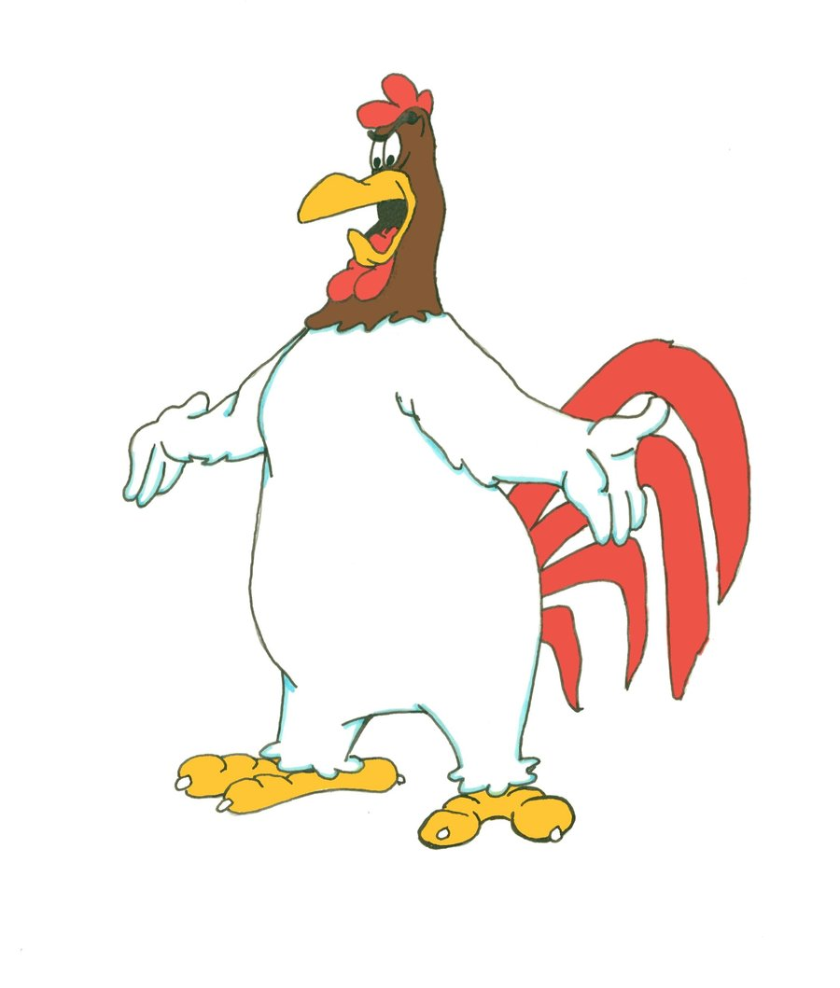
Challenge
Put the:
Movements
OLED Draws
LED Flashing
Together into a program
Notes:
Can Demo Jade Scratch if people are interested. In doing this product I’ve had a few interesting discoveries – one was going with a simpler programming language actually has a *LOT* of value for an expert like myself.

